Slide 1
How does selection affect allele frequencies?

Slide 2
Selection on additive traits
Selection on additive traits leads to the fixation of the favored allele
What determines how fast the favored allele gets fixed?
Fitness
AA
Aa
aa

Slide 3
How does selection affect allele frequencies?
Key variables
Selection coefficient/fitness
Mode of inheritance
Dominant/recessive inheritance
Selection for dominant traits
Selection for recessive traits
Additive inheritance
Heterozygote advantage/disadvantage
Starting allele frequencies
Fitness
Fitness
AA
Aa
aa
AA
Aa
aa
Fitness
Fitness
AA
Aa
aa
AA
Aa
aa

Slide 4
Discussion questions
In relation to the R exercise
If the general null hypothesis is that selection drives alleles to fixation, what did you learn from each of the simulations you ran for today?
Can you explain the reasons underlying the outcomes of each simulation?
Given the outcomes of the simulations, how can genetic variation be maintained in populations?
In what way were these simulations unrealistic? What assumptions were made?

Slide 5
Strength of selection determines…
s=-0.5
s=-0.05
s=-0.1
s=-0.01

Slide 6
Strength of selection determines the speed of change
s=-0.5
s=-0.05
s=-0.1
s=-0.01

Slide 7
Selection on dominant vs. recessive traits
Rare recessive alleles are phenotypically hidden inside heterozygotes and cannot be eliminated from the gene pool by selection alone
Natural selection is most efficient when it acts on rare dominant or common recessive alleles

Slide 8
Selection for heterozygotes
If heterozygotes have the highest fitness, natural selection keeps alleles at a stable, intermediate equilibrium
The equilibrium allele frequency is determined by the fitness difference between the homozygotes (AA vs. aa)
Fitness
AA
Aa
aa
Fitness
AA
Aa
aa
Fitness
AA
Aa
aa

Slide 9
Selection against heterozygotes
If heterozygotes have the lowest fitness, natural selection drives one allele to fixation
The fixed allele depends on the starting allele frequency and the fitness difference between the homozygotes (AA vs. aa)
Equilibrium frequency:
p’ = (w_{Aa}-w_{aa})/(2*w_{Aa}-w_{AA}-w_{aa})
The allele that gets fixed is not always the one that has the highest fitness!
Fitness
AA
Aa
aa
Fitness
AA
Aa
aa

Slide 10
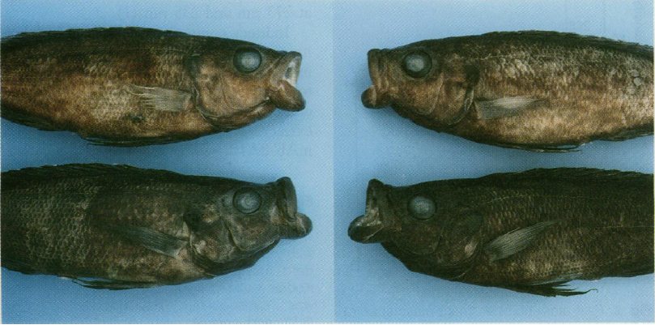
Selection can fluctuate
Environment change
Frequency-dependent selection
Positive
Fitness of genotype increases with its frequency
Rapid fixation of alleles
Negative
Fitness of genotype decreases with its frequency
Fluctuation allele frequency around a long-term mean
Maintenance of multiple alleles in a population
r <- freqdep(p0=0.6, s=1, time=100)

Slide 11
Important conclusions
Selection does not always drive alleles to fixation
Selection can maintain allele frequencies at an intermediate equilibrium
Selection can cause the fixation of alleles that confer lower fitness
In what way were our simulations unrealistic?
What assumptions have we made?
How does selection interact with other evolutionary mechanisms?
Mutation
Genetic drift

